Slide 1
Computer Organization
History of Computers
Prof. Aaradhana Deshmukh

Slide 2
Computer
Definition:
The computer is derived from the word “compute” , which means to calculate. So a computer is normally considered to be a calculating device that can perform arithmetic and logical operations at a very fast speed.
OR
A computer is an electronic device that can accept data, process it and give results after that processing.

Slide 3
Mechanical computers
From The Abacus c. 4000 BCE
to Charles Babbage and his Difference Engine (1812 CE)
Notes:
BCE (Before Common Era) is the now correct term in place of the more traditional BC (Before Christ). CE (Common Era) replaces AD (Anno Domini). After all, not everyone has a Christo-centric view of the world.

Slide 4
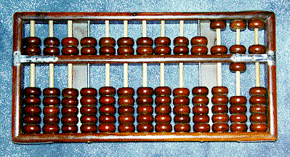
Mechanical computers:
The Abacus (c. 4000 BCE)
Abacus
The earliest device that qualifies as a computer is the abacus. The abacus was invented 5,000 years ago in Asia Minor and is still in use today. This device allows user to calculate, by sliding beads arrangement on rack.

Slide 5
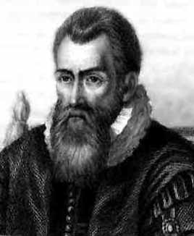
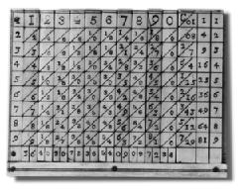
Napier’s Bones and Logarithms (1617)
Notes:
John Napier, a Scotsman, invented logarithms which use lookup tables to find the solution to otherwise tedious and error-prone mathematical calculations.

Slide 6
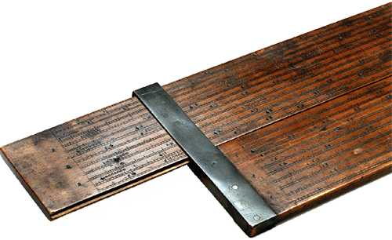
Oughtred’s (1621) and Schickard‘s (1623) slide rule

Slide 7
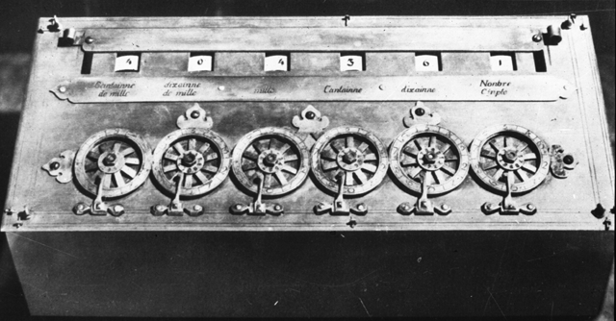
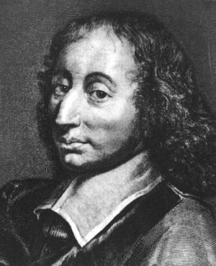
Blaise Pascal’s Pascaline (1645)
Blaise Pascal (1623-1662)
In 1642 Blaise Pascal, the 18 year old son of a French tax collector, invented a numerical wheel calculator to help his father in calculation. This device was known as “Pascaline” and was only able to add two numbers.
Notes:
This famous French philosopher and mathematician invented the first digital calculator to help his father with his work collecting taxes. He worked on it for three years between 1642 and 1645. The device, called the Pascaline, resembled a mechanical calculator of the 1940's. It could add and subtract by the simple rotation of dials on the machine’s face.

Slide 8
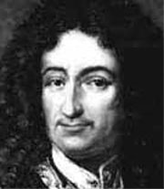
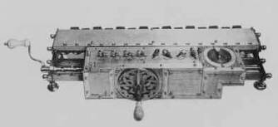
Gottfried Wilhelm von Leibnitz’s
Stepped Reckoner (1674)
Invented by a German Baron, Gottfried von Leibnitz.
Developed through Pascal’s ideas.
It can add, subtract, divide and multiply.
Square roots are performed by series of stepped additions
Notes:
Leibnitz’s Stepped Reckoner could not only add and subtract, but multiply and divide as well. Interesting thing about the Stepped Reckoner is that Leibnitz’s design was way ahead of his time. A working model of the machine didn’t appear till 1791, long after the inventor was dead and gone.

Slide 9
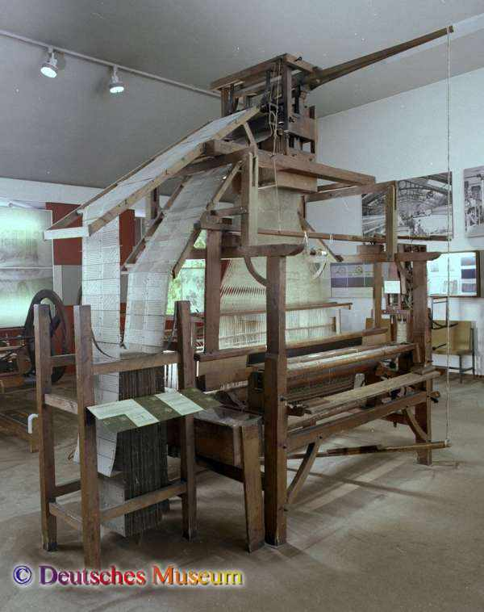
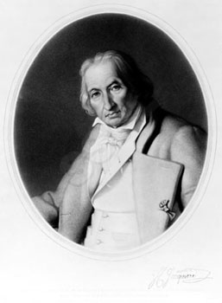
Joseph-Marie Jacquard and his punched card controlled looms (1804)
Notes:
Joseph-Marie Jacquard was a weaver. He was very familiar with the mechanical music boxes and pianolas, pianos played by punched paper tape, which had been around for some time. One day he got the bright idea of adapting the use of punched cards to control his looms. If you look carefully at the picture on the right, and those on the following slide, you can see a continuous roll of these cards, each linked to the other, the holes in them punched strategically to control the pattern of the weave in the cloth produced by the loom. All the weaver had to do was work the loom without needing to think about the design of the cloth. Brilliant! Jacquard revolutionized patterned textile weaving. His invention also provided a model for the input and output of data in the electro-mechanical and electronic computing industry.

Slide 10
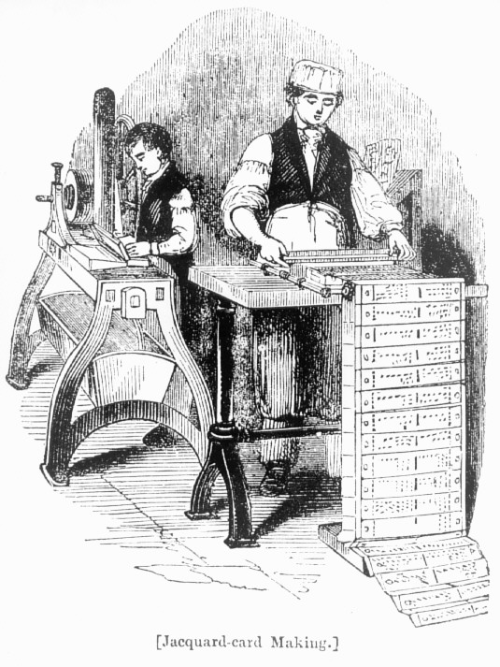
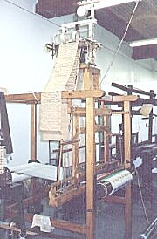
Preparing the cards with the pattern for the cloth to be woven
Notes:
Here you see Jacquard’s workers preparing the cards for the looms. The looms became known as Jacquard looms, and today one of the premier fabric manufacturers is named after Joseph-Marie Jacquard.

Slide 11
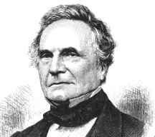
Charles Babbage (1791-1871)
The Father of Computers
Charles Babbage (1791-1871)
An English mathematician, Professor Charles Babbage made a “difference Engine” in 1833, which was powered by steam to solve mathematical equations. After 10 years, in 1842, he made a general purpose computer named “Analytical Engine”. This analytical engine could add, subtract, multiply and divide in automatic sequence at a rate of 60 additions per second.
Notes:
Charles Babbage is recognized today as the Father of Computers because his impressive designs for the Difference Engine and Analytical Engine foreshadowed the invention of the modern electronic digital computer. Try and get a biography of Babbage if you can. He led a fascinating life, as did all the folks involved in the history of computers. He also invented the cowcatcher, dynamometer, standard railroad gauge, uniform postal rates, occulting lights for lighthouses, Greenwich time signals, heliograph opthalmoscope. He also had an interest in cyphers and lock-picking, but abhorred street musicians.

Slide 12
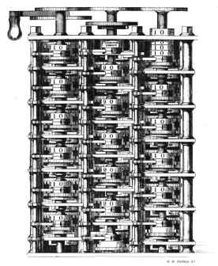
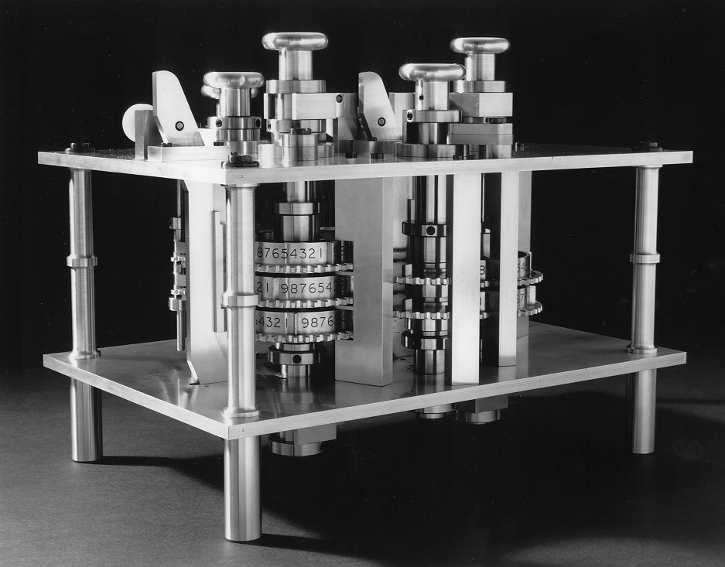
Charles Babbage’s Difference Engine
Notes:
The precision machine tooling that produced these intricate machines could not have been achieved in an earlier age. Babbage’s inventions were born of the advances in technology that accompanied the Industrial Revolution. The Difference Engine was never fully built. Babbage drew up the blueprints for it while still an undergrad at Cambridge University in England. But while it was in process of being manufactured, he got a better idea and left this work unfinished in favor of the Analytical Engine illustrated on the next slide. The Analytical Engine was eventually built completely in the latter half of the 19th century, by Georg and Edvard Schuetz as per Babbage’s blueprints. Film footage exists of the machine in operation, and it is truly a sight to behold, a testament not only to Babbage’s genius, but also to the manufacturing prowess of the age.

Slide 13
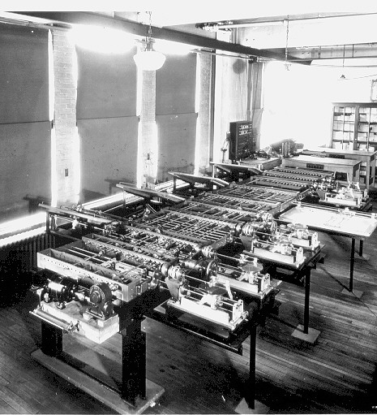
Charles Babbage’s Analytical Engine
Notes:
Charles Babbage’s Analytical Engine Charles Babbage’s Analytical Engine. The Analytical Engine was intended to use loops of Jacquard's punched cards to control an automatic calculator, which could make decisions based on the results of previous computations. This machine was also intended to employ several features subsequently used in modern computers, including sequential control, branching, and looping.

Slide 14
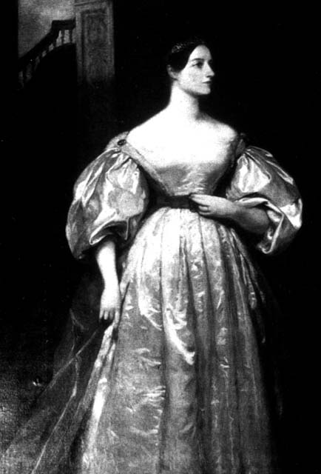
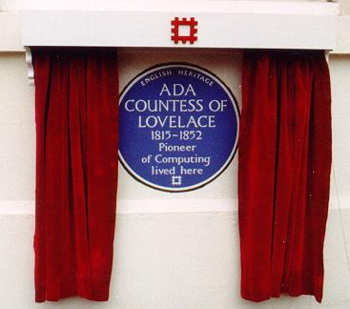
Lady Augusta Ada
Countess of Lovelace
Lady Ada Augusta Lovelace (1816-1852)
Lady Ada Augusta Lovelace was an English woman. Charles Babbage was her ideal. She studied and translated his works, adding her extensive footnotes. She was called as a first programmer because of her suggestion that punched cards could be prepared to instruct Babbage’s engine to repeat certain operations.
Notes:
Babbage owes a great debt to Lady Augusta Ada, Countess of Lovelace. Daughter of the famous romantic poet, Lord Byron, she was a brilliant mathematician who helped Babbage in his work. Above all, she documented his work, which Babbage never could bother to do. As a result we know about Babbage at all. Ada, who was a splendid mathematician and one of the few people who fully understood Babbage's vision, created a program for the Analytical Engine.
Had the Analytical Engine ever actually worked, Ada's program would have been able to compute a mathematical sequence known as Bernoulli numbers. Based on this work, Ada is now credited as being the first computer programmer and, in 1979, a modern programming language was named ADA in her honor. remember that guys. Women are just as talented as men when it comes to math, science, and engineering, and society should recognize that and do its utmost to encourage girls to get into these important and lucrative fields.

Slide 15
Electro-mechanical computers
From Herman Hollerith’s 1890 Census Counting Machine
to Howard Aiken and the Harvard Mark I (1944)
Notes:
Electricity was discovered long before it was actually named as such. One Sir Thomas Browne is supposed to have come up with the term “electricity”. It was a while before electricity was used to power computing machines.

Slide 16
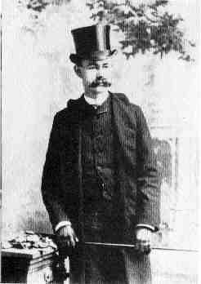
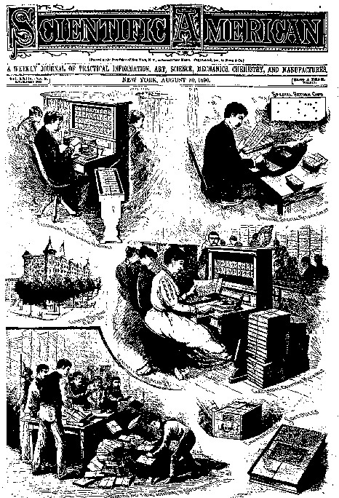
Herman Hollerith and his
Census Tabulating Machine (1884)
Herman Hollerith (1860-1929)
In 1890, an American Herman Hollerith applied the idea of punchboards in the form of punch cards in computers for input and output. He invented a punched card tabulating machine.
Notes:
Herman Hollerith worked as a statistician for the U.S. Census Bureau in the 1880s and 1890s. The U.S. Constitution requires a census count every ten years so that the membership of the House of Representatives will be proportional to the population of each state. This is always a moving target, hence the ten year review of the current state of demographic affairs. The 1880 census took seven years to process. The end of the 19th/beginning of the 20th centuries was the period of highest rate of immigration to the United States. Hollerith deduced, and it didn’t take a rocket scientist to conclude, that the next census would take longer than ten years, the results not available before the whole census counting thing had to start again.
So, as the saying goes, “necessity became the mother of invention” and Hollerith designed and built the Census Counting Machine illustrated here and in the next slide. Punched cards (a la Jacquard looms) were used to collect the census data (the origin of the IBM punched cards) and the cards were fed into a sorting machine before being read by the census counting machine which recorded and tabulated the results. Each card was laid on an open grid. A matrix of wires was lowered onto the card and wherever there was a hole in the card, a wire fell through, making an electrical connection which triggered a count on the appropriate dial(s) in the face of the machine. Very simple, very effective. The 1890 census took just three months to process even though quite a bit more data was collected than ever before.
Hollerith was the first American associated with the history of computers. As you might expect, he was also the first to make a bunch of money at it. His company, the Tabulating Machine Company, became the Computer Tabulating Recording Company in 1913 after struggling in the market and merging with another company that produced a similar product. The company hired a gentleman named Thomas J. Watson in 1918 who was primarily instrumental in turning the company around. In 1924, the company was renamed International Business machines (IBM) Corporation. The rest, as they say, is history…

Slide 17
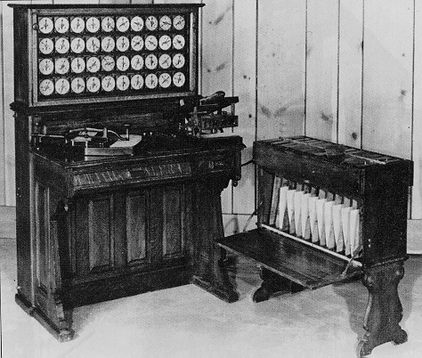
A closer look at the Census Tabulating Machine
Notes:
Here you can see the sorter on the right and the census counting machine on the left.

Slide 18
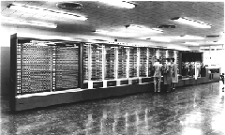
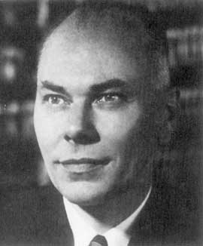
The Harvard Mark I (1944) aka IBM’s Automatic Sequence Controlled Calculator (ASCC)
Notes:
While a professor of Physics at Harvard, Howard Aiken, illustrated above, was supported by IBM to build the ASCC computer (Automatic Sequence Controlled Calculator). The computer had mechanical relays (switches) which flip-flopped back and forth to represent mathematical data. It was huge (of course), weighing some 35 tons with 500 miles of wiring. The guts of the machine was comprised of IBM counting machines.

Slide 19
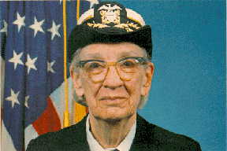
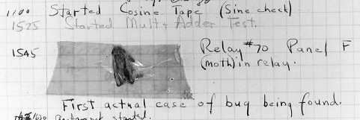
Rear Admiral Dr. Grace Murray Hopper
The first computer bug
Notes:
This is a picture of the first computer bug. The lady is U.S. Rear Admiral Dr. Grace Murray Hopper, who worked with Howard Aiken from 1944 and used his machine for gunnery and ballistics calculation for the US Bureau of Ordnance’s Computation project. One day, the program she was running gave incorrect results and, upon examination, a moth was found blocking one of the relays. The bug was removed and the program performed to perfection. Since then, a program error in a computer has been called a bug, even though it would take a mighty tiny bug to interfere with the workings of a modern microscopic microprocessor.
Nancy Head has contributed the following additional information about Dr. Hopper:
Dr. Hopper greatly simplified programming through the COBOL language which was the first programming language to allow the use of regular English for variable names and logical operations. She also introduced the concept and standardization of "compilers“, now a standard feature of programming languages. The compiler translates the programmer’s code into machine language, thus sparing the programmer the onerous task of doing it herself. This contributed to business use of computers and modern data processing because regular businesspersons and scientists (not just mathematicians and computer scientists) could learn to program computers.
More about her life and software engineering contributions can be found at http://www.sdsc.edu/ScienceWomen/hopper.html and http://www.cs.yale.edu/homes/tap/Files/hopper-story.html.
Some fun/interesting quotes from her can be found at http://www.cs.yale.edu/homes/tap/Files/hopper-wit.html.

Slide 20
Electronic digital computers
From John Vincent Atanasoff’s 1939 Atanasoff-Berry Computer (ABC)
to the present day
Notes:
John Vincent Atanasoff’s contribution to the history of computers is little known, thanks to the preoccupations of his university and the shenanigans of two rival inventors of electronic digital machines. Read on to find out more…

Slide 21
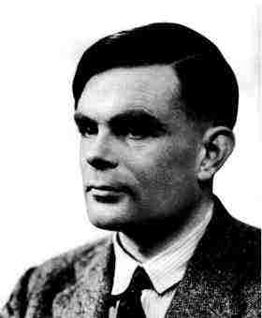
Alan Turing
1912-1954
The Turing Machine
Aka
The Universal Machine
1936
Notes:
The story of modern electronic digital computing should start with Alan Turing who published a paper in 1936 On Computable Numbers, with an application to the Entscheidungs problem. The paper proved that a machine capable of processing a stream of 1s and 0s according to programmed instructions would be capable of solving any problem that would count as a 'definite method.' As it happens, the set of problems included in this definition is the universe of mechanically solvable problems. Hence, the Turing Machine is also known as the Universal Machine, the theoretical precursor to the electronic digital computer which Atanasoff was soon to invent.

Slide 22
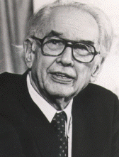
John Vincent Atanasoff (1903-1995)
Physics Prof at
Iowa State
University, Ames, IA
Notes:
Interesting story of how Atanasoff came up with the stroke of genius to design his computer the way he did. He’d been thinking about it for a long time, convinced there had to be a way of doing math mechanically and thus save his PhD students at Iowa State College (now Iowa State University) in Ames, Iowa, from wasting time on math when they could be doing more interesting work in Physics. One evening in the winter of 1937, the problem proved particularly taxing for him, so he did what he was accustomed to doing in situations such as this: he got into his car and drove at high speeds for several hours, thus effectively clearing his mind. Eventually he crossed into the neighboring state of Illinois and stopped at a bar where he ordered a draft of liquid refreshment (bourbon). This had a wondrous effect on his state of mind, enabling him to think with a calm clarity that led step-by-step to coherent conclusions about the design of his electronic digital computer.
Back at the lab, in the Spring of 1939, he hired Clifford Berry, an bright electrical engineering student, and together they invented the Atanasoff-Berry Computer, the ABC. Within a year, the basic machine was completed and a paper written documenting its design. The paper was forwarded to the university’s patent lawyer. With World War II well underway, Atanasoff was given leave from the university to join the Naval Ordnance Laboratory for defense-related work. Work on the ABC came to a halt. The patent was never filed….

Slide 23
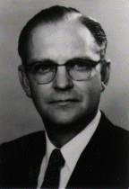
Clifford Berry (1918-1963)
PhD student
of
Dr. Atanasoff’s
Notes:
Dr. Clifford Berry had a distinguished career of his own outside of contribution in the invention of the electronic digital computer. He was issued 19 patents in the area of mass spectrometry, 11 patents in various areas of vacuum and electronics and, at the time of his death, had 13 patents pending. He died suddenly on October 30, 1963.

Slide 24
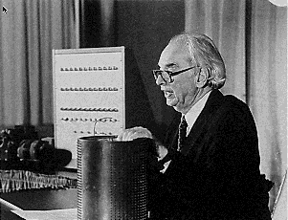
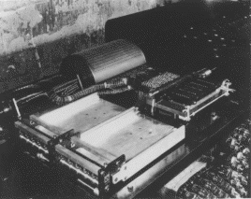
1939
The Atanasoff-Berry Computer (ABC)
Notes:
The ABC was a digital computer, so-called because it processed data in discrete, digital units (the digits 1 and 0). It also used the binary (base 2) number system in computation, the results being converted to and from decimal (base 10) for the purposes of human consumption. Being binary, the data could easily be represented electronically since switches naturally have two states—on and off—which lend themselves to representing the numbers or values 1 and 0. The ABC used vacuum tubes, punched cards and a memory device that looked like a drum (shown in the pictures on the slide being held by Atanasoff and as it was located in the working machine).

Slide 25
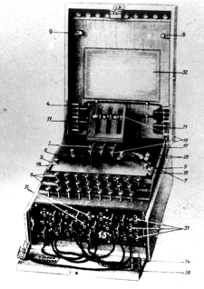
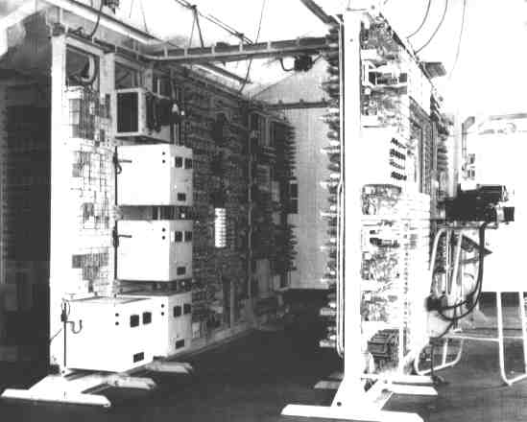
1943
Bletchley Park’s Colossus
The Enigma Machine
Notes:
Another little known story in the history of computers relates the work of the government boffins in World War II Britain, Turing included. Turing made a major contribution to the development of a sophisticated computing machine called the Colossus which was used to help crack the codes of the German Enigma Machine. The story didn’t come out till the 1970s because it was top secret, for obvious reasons.
You can read more about cryptography in a fascinating book written by Simon Singh: THE CODE BOOK. The Secret History of Codes and Code-Breaking.
Those of you interested in learning more about cryptography and even using cryptography to protect your privacy can work your way through our tutorial on PGP (Pretty Good Privacy) which you will find available free of charge online at http://www.pitt.edu/~poole/PGPintro.htm.

Slide 26
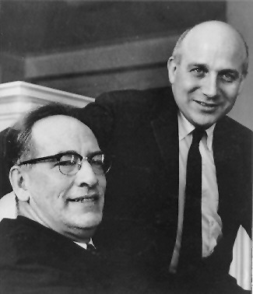
1946
The ENIAC
John Presper Eckert
(1919-1995)
and
John Mauchly
(1907-1980)
of the
University of Pennsylvania Moore School of Engineering
Notes:
J. Presper Eckert (at right in the picture on this slide) and John Mauchly were professors in the Moore School of Engineering at the University of Pennsylvania. Mauchly invited himself to Atanasoff’s home for a long weekend in order to check out the ABC. Atanasoff made him welcome, showed him his machine, and gave him a copy of the paper describing the workings of the machine that already had been filed with the Iowa State College’s patent lawyer. Mauchly returned to Pennsylvania and, together with Eckert, designed and built the ENIAC (Electronic Numerical Integrator and Computer) which was commissioned by the U.S. Department of Defense and delivered in 1946.
Eckert and Mauchly successfully filed for the patent as inventors of the electronic digital computer, ignoring Atanasoff’s work. Some thirty years later, in 1972, this injustice was rectified when Honeywell (for Atanasoff) successfully challenged Sperry Rand (the company that acquired Eckert and Mauchly’s patent), and Atanasoff and Berry were duly credited as being the inventors of the electronic digital computer.
Mauchly died in 1980. Eckert died in 1995, one week before the nonogenarian Atanasoff. You might say that Atanasoff had the last laugh.

Slide 27
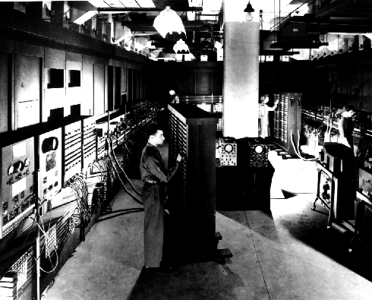
The ENIAC: Electronic Numerical Integrator and Computer
ENIAC (Electronic Numerical Integrator and Computer) was made by Dr. John W. Mauchly collaborated with J. Presper Eckert, Jr. at the University of Pennsylvania. It was 1000 times faster than Mark I. It occupied 15000 square feet of floor spacing and weighs 30 tons. The ENIAC could do 5000 additions per minute. John Von Neumann designed the EDVAC (Electronic Discrete Variable Automatic Computer).
Notes:
The ENIAC: 30 tons, 18,000 vacuum tubes, with the computing power of little more than the modern calculator…..

Slide 28
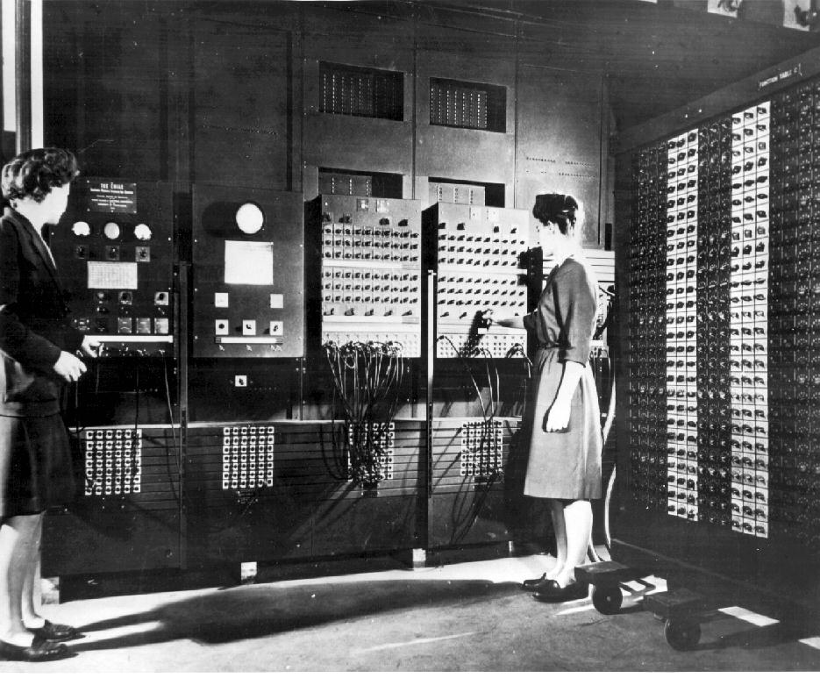
Programming the ENIAC
Notes:
The ENIAC was programmed by rewiring the machine, instruction by instruction, tedious work carried out mostly by women working for the U.S. Ordnance Office. The machine was intended for use in the calculation of ballistics trajectories for the big guns of World War II. It was ready a bit late for that, but nonetheless was an immensely significant achievement on Eckert and Mauchly’s part. Such a shame they neglected to recognize Atanasoff’s contribution to their endeavors.
The lady programmers were known as computers, for a while at least…..

Slide 29
EDVAC
  Proposed by Mauchly and Eckert in August 1944.
  Stands for Electronic Discrete Variable Automatic Computer.
  Its conceptual design was completed by 1946 but it became fully operational by 1952.

Slide 30
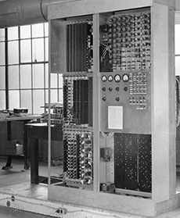
  Contained approximately 4000 vacuum tubes and 10,000 crystal diodes.

Slide 31
EDSAC
  Stands for Electronic Delay Storage Automatic Calculator.
  Performed its first calculation at Cambridge University, England in May 1949.
  Contained 3,000 vacuum tubes and used mercury delay lines for memory.
  Programs were inputted using paper tape and outputted results were passed to a teleprinter.
  Used one of the first assemblers called “Initial Orders”, which allowed it to be programmed symbolically instead of using machine code.

Slide 32
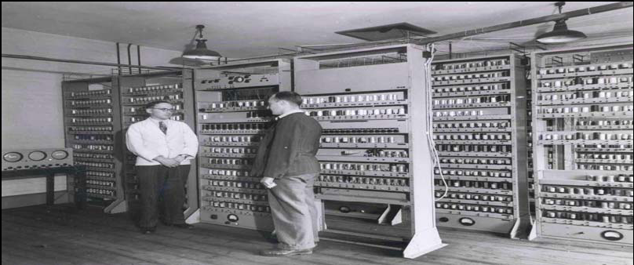
EDSAC

Slide 33
UNIVAC
  First commercially available computer.
  Stands for Universal Automatic Computer.
  It was based on the EDVAC design.
  The development started on 1948 and the first unit was delivered on 1951, which therefore predates EDVAC’s becoming fully operational.

Slide 34
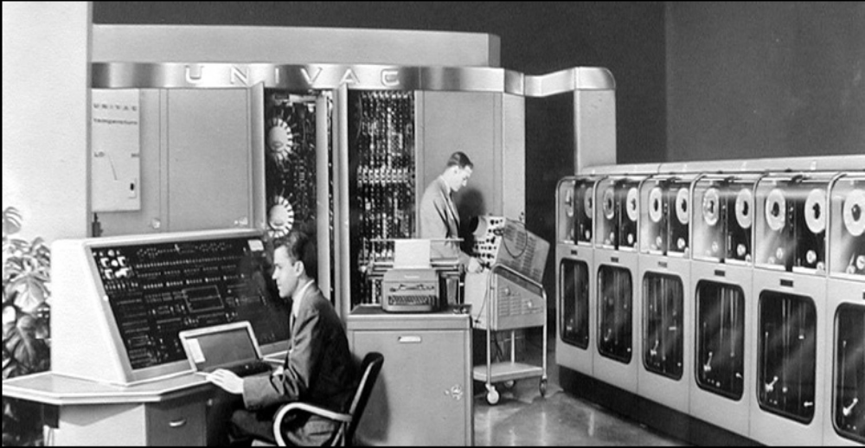
UNIVAC

Slide 35
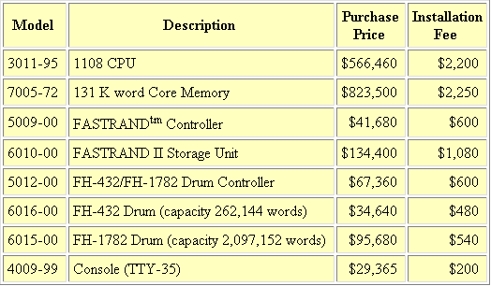
Univac
Notes:
Tote it up… $1,801,035 in 1968 dollars. According to The Inflation Calculator found at http://www.westegg.com/inflation/, it would be about $8,973,207 in year 2000 dollars. So you’d have to multiply that by five, easy, in today’s money, and all for the equivalent of the calculator you keep in your school bag.

Slide 36
1952 – 1960
1953 The IBM 701 becomes available to the scientific community. A total of 19 are produced and sold.
1954 IBM produces and markets the IBM 650. More than 1,800 of these computers are sold in an eight-year span
1955 Bell Labs introduces its first transistor computer. Transistors are faster, smaller and create less heat than traditional vacuum tubs, making these computers more reliable and efficient.
1955 The ENIAC is turned off for the last time. It’s estimated to have done more arithmetic than the entire human race had done prior to 1945.
1956 IBM’s 3005 RAMAC is the first computer to be shipped with a hard disk drive.
1957 IBM announces it will no longer be using vacuum tubes and releases its first computer that had 2000 transistors.
1957 Russia launches the first artificial satellite, named sputnik.
1958 The first integrated chip is first developed by Robert Noyce of Fairchild Semiconductor and Jack Kilby of Texas Instruments. The first microchip was demonstrated on September 12, 1958.

Slide 37
1960 – 1971
1961 General Motors puts the first industrial robot – the 4,000 pound Unimate – to work in a New Jersey factory.
1963 Doug Engelbart invents and patents the first computer mouse.
1963 The American Standard Code for Information Interchange (ASCII) is developed to standardize data exchange among computers.
1964 Dartmouth University’s John Kemeny and Thomas Kurtz develop Beginner’s All-purpose Symbolic Instruction Language (BASIC).
1965 Ted Nelson coins the term "hypertext," which refers to text that is not necessarily linear.
1967 IBM creates the first floppy disk.
1969 AT&T Bell Laboratories develop Unix.
1969 The U.S. Department of Defense sets up the Advanced Research Projects Agency Network (ARPANET ) this network was the first building blocks to what the internet is today.
1970 Intel announces the 1103, a new memory chip containing more than 1,000 bits of information. This chip is classified as random-access memory (RAM).
1970 Intel introduces the first microprocessor, the Intel 4004.
1971 The first 8" floppy diskette drive was introduced
1971 The first laser printer is developed at Xerox PARC.

Slide 38
1972 – 1980
1972 Atari releases Pong, the first commercial video game.
1972 The compact disc is invented in the United States.
1973 Robert Metcalfe creates the Ethernet at the Xerox Palo Alto Research Center (PARC).
1974 Intel’s improved microprocessor chip, the 8080 becomes a standard in the microcomputing industry.
1974 IBM develops SEQUEL, which today is known as SQL today.
1975 MITS ships one of the first PCs, the Altair 8800 with one kilobyte (KB) of memory. The computer is ordered as a mail-order kit for $397.00
1975 Paul Allen and Bill Gates write the first computer language program for personal computers, which is a form of BASIC designed for the Altair.
1975 Steve Wozniak and Steve Jobs co-found Apple Computers.
1976 The first 5.25-inch floppy disk is invented.
1976 Microsoft introduces an improved version of BASIC.
1976 The Intel 8086 is introduced.
1978 The 5.25-inch floppy disk becomes an industry standard.
1979 Texas Instruments enters the computer market with the TI 99/4 personal computer that sells for $1,500.
1979 Atari introduces a coin-operated version of Asteroids.
1979 More then half a million computers are in use in the United States.
1979 The Motorola 6800 is released and is later chosen as the processor for the Apple Macintosh.

Slide 39
Acknowledgements
Bullet items of history taken from www.computerhope.com
Early history based on a presentation by Bernard John Poole, MSIS
  Associate Professor of Education and Instructional Technology, University of Pittsburgh at Johnstown

Slide 40
Generations of Computers
A term which refers to the different advancements of computer technology characterized by the way computers operate resulting to miniaturization, speed, power, and proportionally increased memory.

Slide 41
1st Generation (1940 – 1956)
Computers are huge, slow, expensive, and often undependable.
They used vacuum tubes for circuitry.
They used magnetic drums for memory.

Slide 42
Vacuum Tubes

Slide 43
2nd Generation (1956 – 1963)
Transistors (1947) were already used and replaced vacuum tubes.
Transistors allow computers to become smaller, faster, cheaper, more energy-efficient, and more reliable.
One transistor is equivalent to 40 vacuum tubes.
Heat generation problem that could inflict damage to computer is still existing.

Slide 44
Transistor

Slide 45
3rd Generation (1964 – 1971)
The emergence of integrated circuits was the hallmark of the 3rd generation of computers.
Transistors were miniaturized and placed on silicon chips, called semiconductors.
Computer’s speed drastically increased as well as its efficiency.
Computers became accessible to the mass since it is smaller and cheaper.

Slide 46
Integrated Circuits

Slide 47
4th Generation (1971 – Present)
The microprocessor brought the fourth generation of computers, as thousands of integrated circuits were built onto a single silicon chip.
Computers are now very small.
Microprocessors was intended for calculators but applied to computers later.
Graphical User Interfaces (GUIs), mouse and handheld devices are introduced.

Slide 48
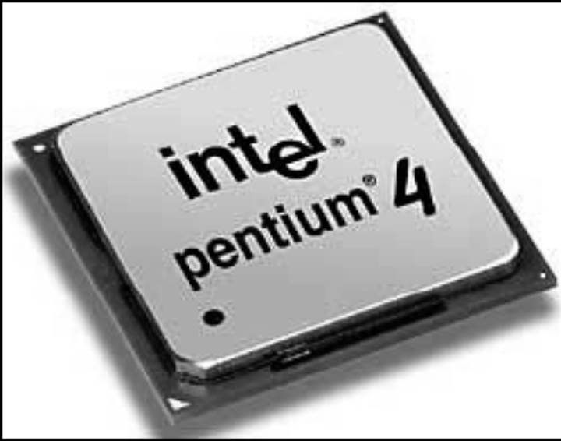
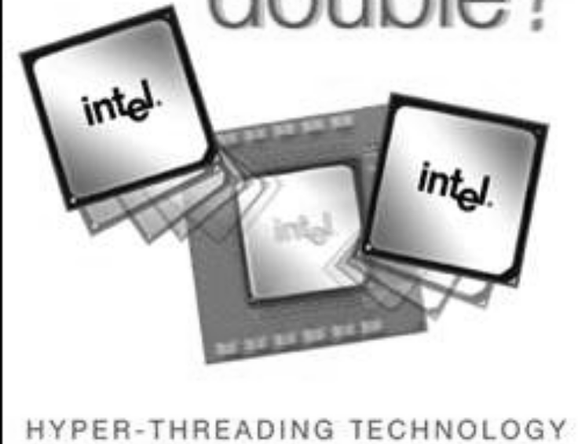
Microprocessors

Slide 49
5th Generation (Present and Beyond)
Artificial Intelligence is still under development although voice recognition are being used today.
Quantum computation, and molecular and nanotechnology will radically change the face of computers in years to come.
The goal is to develop devices that respond to natural language input and capable of learning and self-organization.

Slide 50
TYPES OF COMPUTERS
On the basis of principles of construction, computers are divided into three types:-
    Analog Computers.
    Digital Computers.
    Hybrid Computers.
1. Analog Computers
Analog quantities show the continuity of a specified value. Analog computers are devices, which are used to measure continuous values.

Slide 51
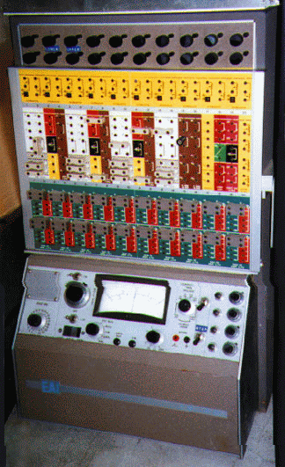
ANALOG COMPUTER

Slide 52
2.Digital Computers
Classification of Digital Computers.
Digital means discrete. With digital signal, everything is described in two states either on or off. A digital computer is based on the rule of counting. In fact, digital computers use digital signals, which can distinguish between just two values 0 and 1.
Example
Digital watches are the good example of a digital computer, because the time, which is displayed, does not vary continuously but changes from one discrete value to another.

Slide 53
Digital Computers
Computers are classified according to speed, size and memory capacity. Computers are of different types:-
Supercomputer
Mainframe
Mini
Micro/PC/Desktop
Laptop

Slide 54
Supercomputer
They are the largest, faster and the most expensive computer systems in the world. They are used to process complex scientific jobs. They are considered to be the resources of any nation.
Unlike other computers, supercomputers are based on the concept of parallel processing i.e. to perform one million-billion (10^15) math operations per second.

Slide 55
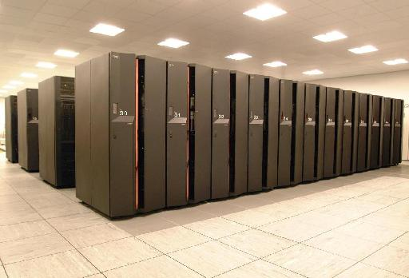
SUPERCOMPUTER

Slide 56
Mainframe Computers
The mainframe computers are large computers available in different models, capacities and prices. Their main characteristics are:
They are based on the principle of strong physical computing power. Hence many people can make use of this machine at the same time.

Slide 57
MAIN FRAME Computer
They are sensitive to variations in temperature, humidity, dust, etc. and are hence kept in controlled environment, i.e., air conditioned rooms.
Qualified operators and programmers are required for their operations.
They have a large storage capacity.
They can make use of a wide variety of software.

Slide 58
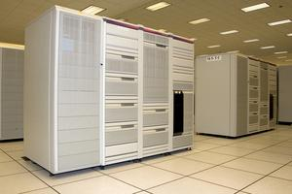
MAIN FRAME Computer

Slide 59
Mini Computers
Micro computers were introduced in the 1960s. They have less capacity to manipulate and store data, compared to mainframe computers. Some of the characteristics of minicomputers in relation to mainframe computers are:
Limited software can be used.
There is facility for direct operation of the machine by the end user.

Slide 60
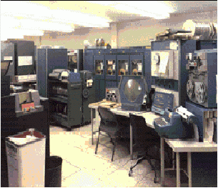
MINI COMPUTER

Slide 61
Micro / Personal Computer
  The Micro/ Personal Computers
These computers are used now days commonly and these computers revolutionized the computers industry because of their size and cost. Some of the features are:
  They are cheap and easy to use.
  They have limited input and output capacities.
  They have low storage capacity.
  They are designed to be used by one person at a time.

Slide 62
Desktop Computers
Desktops or PCs, are used by one person at a time. They are usually single user machines but can be interconnected among themselves to form a local area network (LAN). Their speed depends upon the processor installed in the computer. They are also low in price.

Slide 63
Laptop Computers
These are light and compact and are called portable because they work on batteries and can operate without an external power source. Laptops, which weigh from four to eight pounds, are often called notebook PCs because they are about the size of a one-inch thick notebook
Hybrid Computers
A computer that combines the characters of both analog and digital computer is known as Hybrid computer.

Slide 64
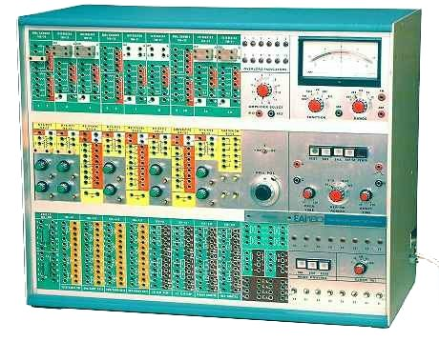
HYBRID COMPUTER

